Slide 1
Digital Logic Design Equipment Training
Fall 2024

Slide 2
Training Objectives
Breadboards
Wiring
Power Supply
Voltmeter
Logic Probe
Logic Chips
Switch Input
LED Output
Experiment – Digital Combination Lock

Slide 3
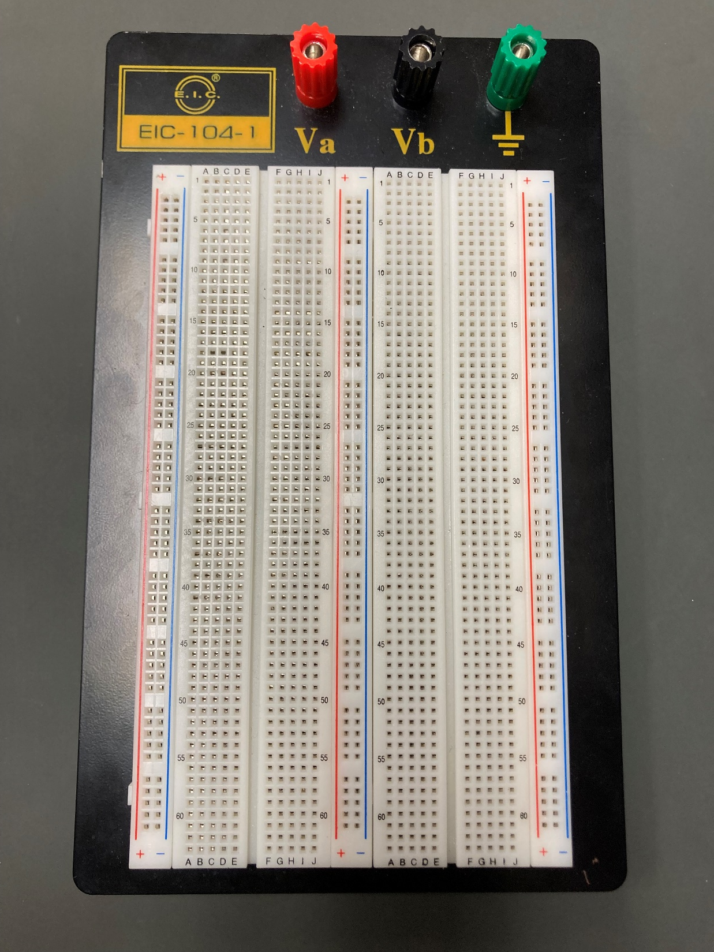
Breadboards
You will create all your circuits on breadboards like this one
The Breadboard allows you to easily construct a circuit, make changes to it, and disassemble it.

Slide 4
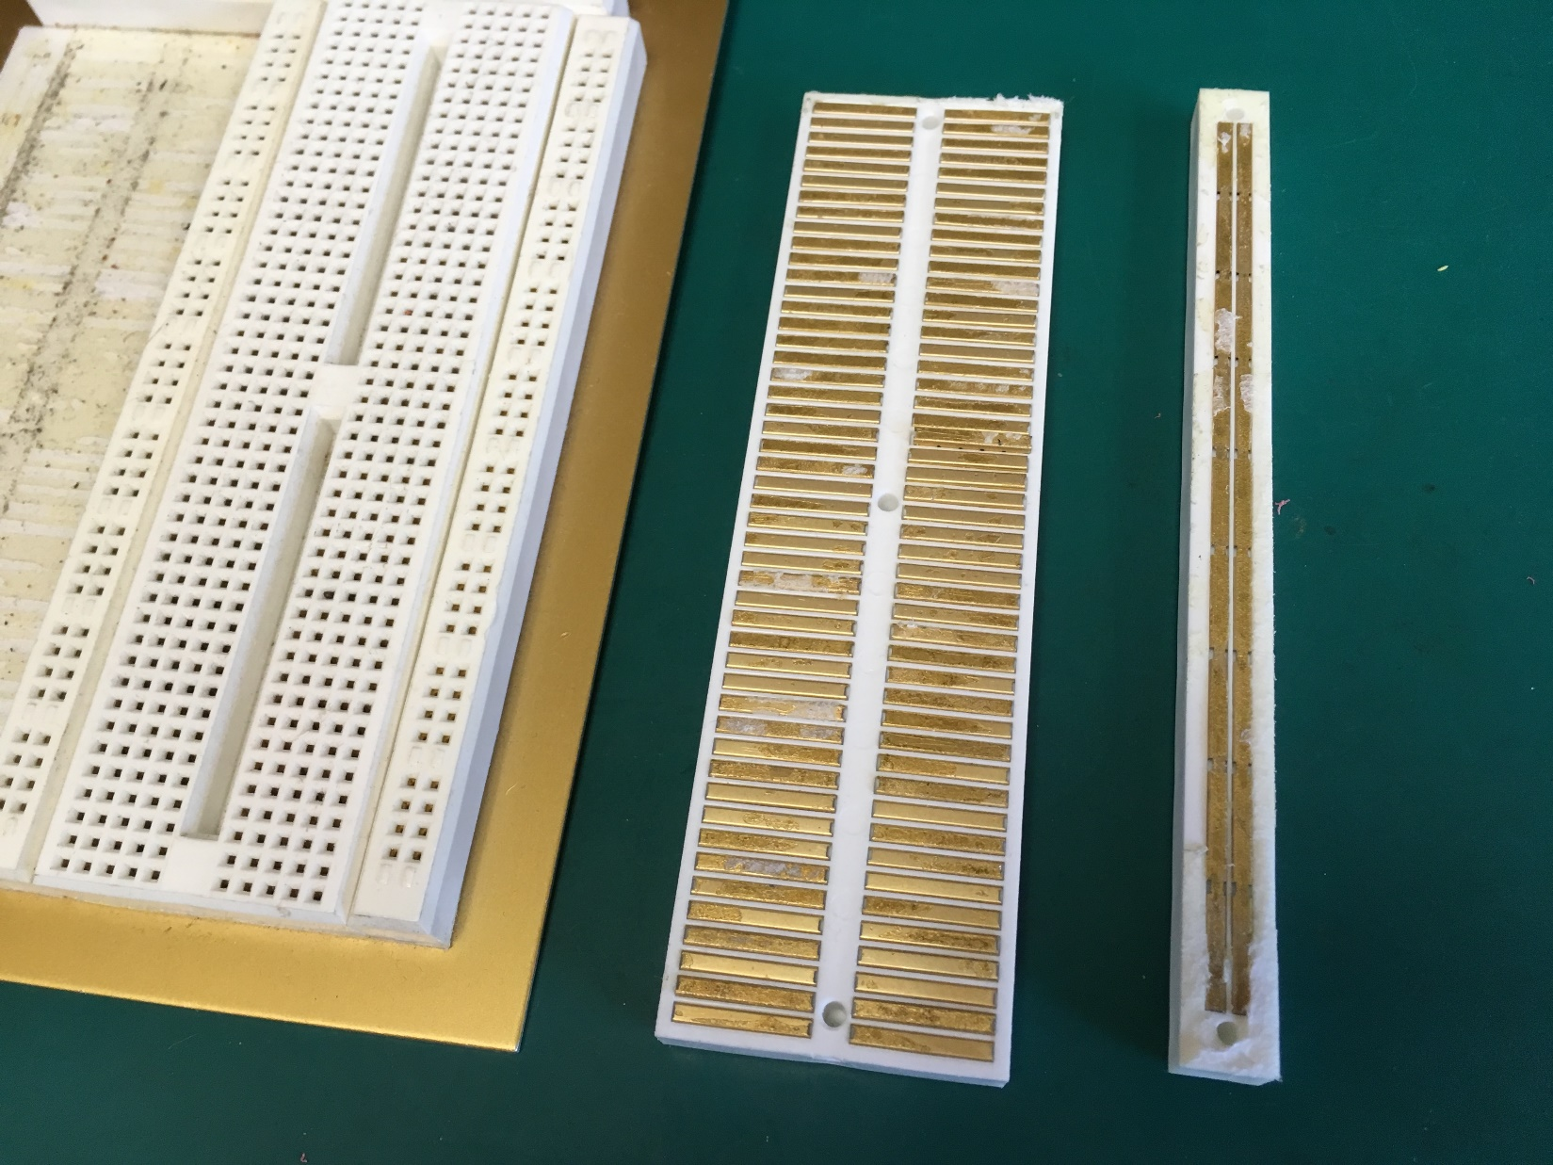
Breadboards
The holes are connected together in the back with metal strips.
So these five holes are connected electrically.
And all these holes are connected.

Slide 5
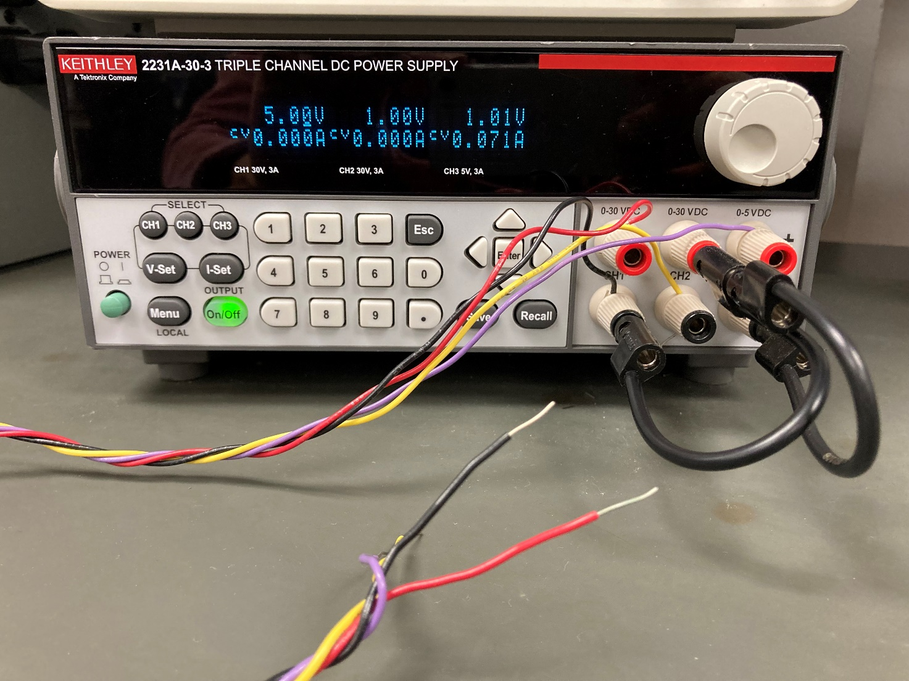
Power Supply
The logic circuits we will be using all require 5 VDC to operate.
You will get the 5V power from a power supply that probably looks like this.
The wiring is already connected:
RED wire is +5V
BLACK wire is Ground

Slide 6
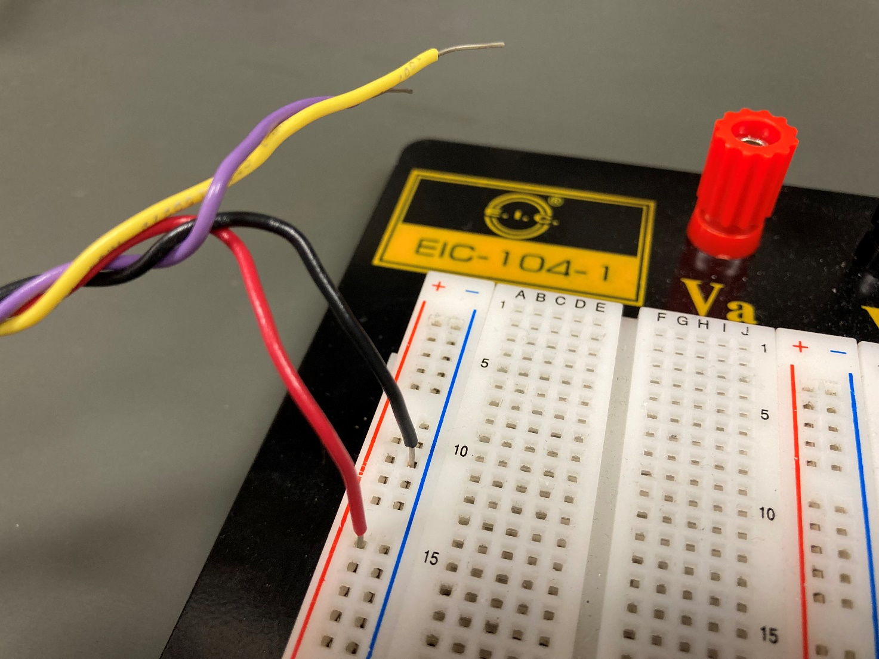
Power Supply
Connect your power supply to your breadboard.
Connect the RED wire to the RED bus.
Connect the BLACK wire to the BLUE bus. For whatever reason, they used blue instead of black.

Slide 7
Power Supply
Turn on your power supply.
Program your power supply channel 1 for 5 Volts. Push the CH1 button, then 5, then Enter.
Push the On/Off button. This will energize all the outputs.

Slide 8
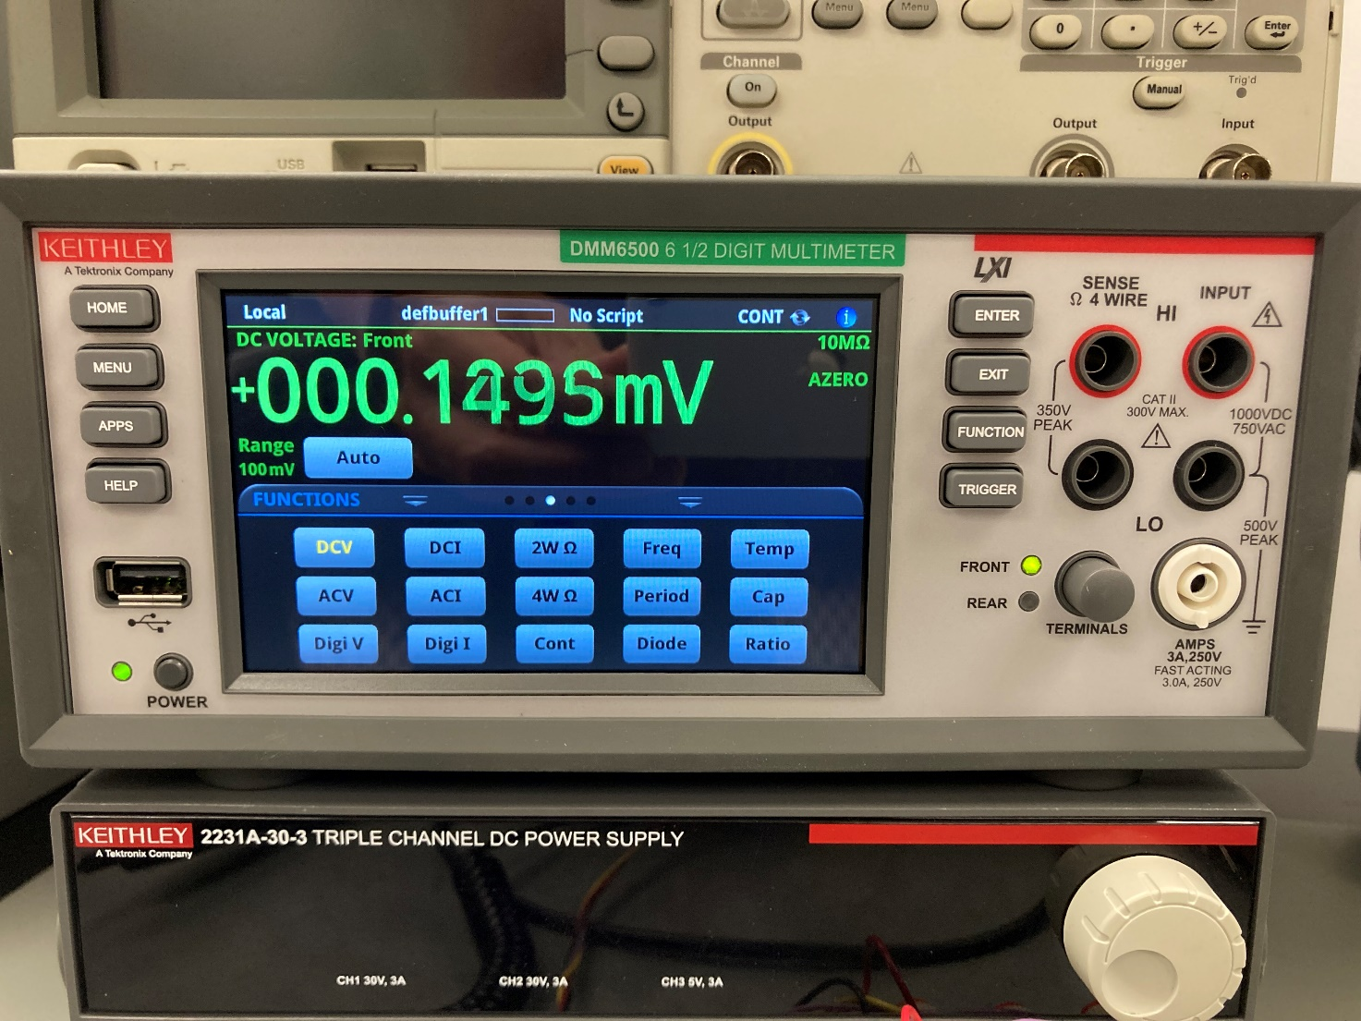
Voltmeter
You might need to use the voltmeter to see what is going on inside your circuit.
Your meter will probably look like this.
Turn it on, and push the DCV button for measuring DC Voltage.

Slide 9
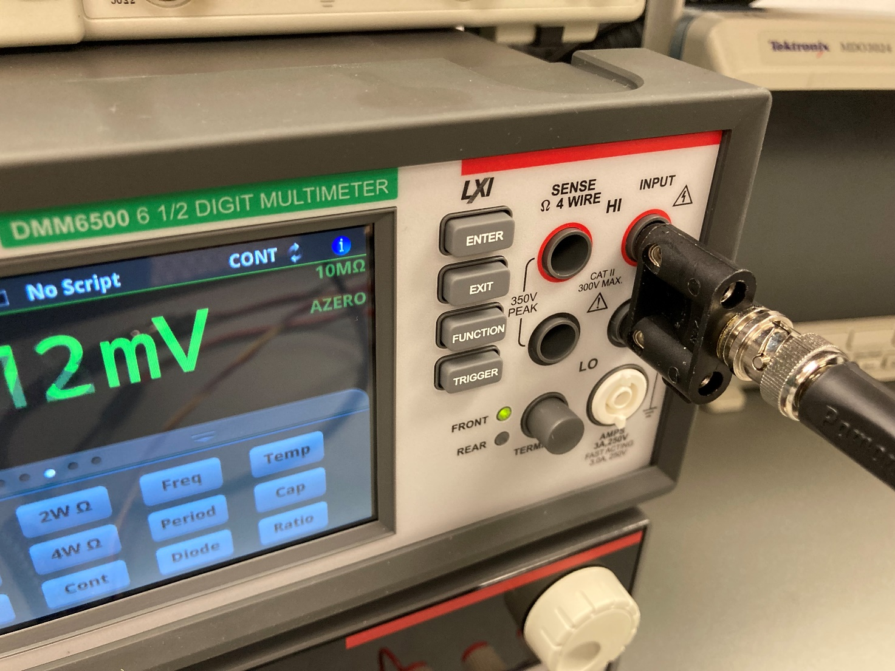
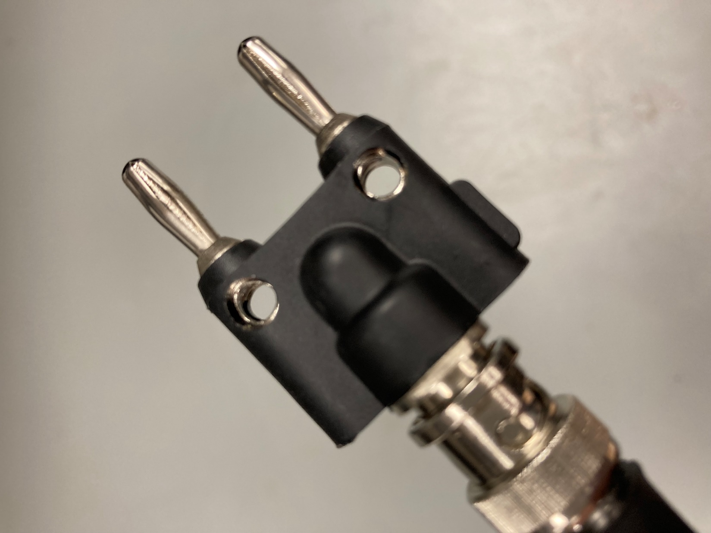
Voltmeter
Connect your voltmeter to your breadboard using the banana-plug/coax/mini-grabber cable.
There is a small tab on one side of the banana-plug – this goes in the black ground hole on the voltmeter.
The meter should read +5 volts.

Slide 10
Bring up all 12 voltmeters on the screen, and make sure they all say +5 VDC.

Slide 11
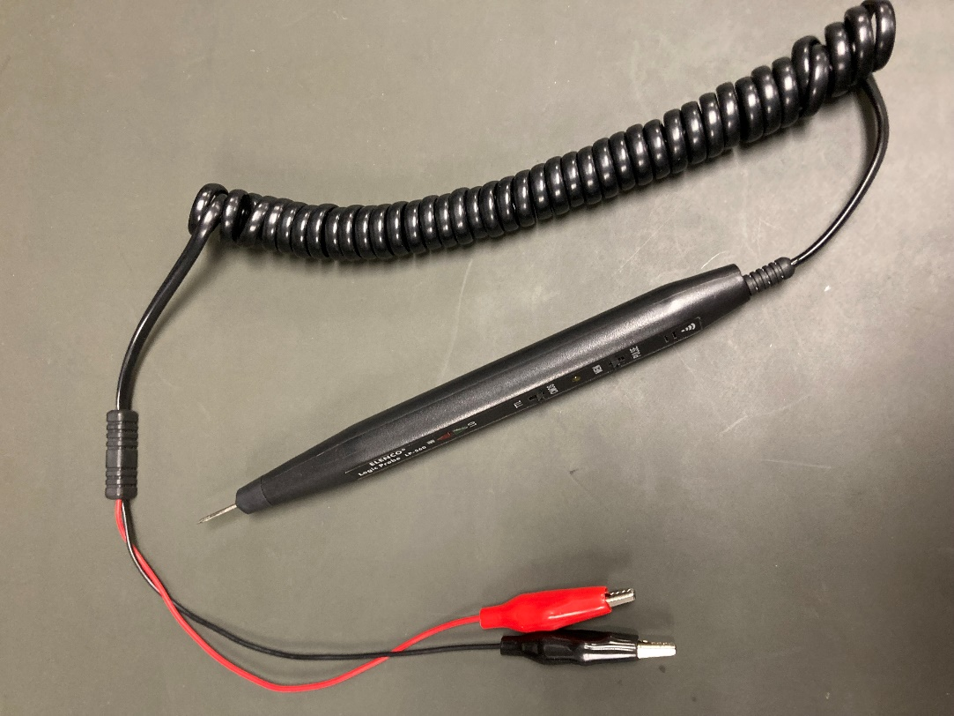
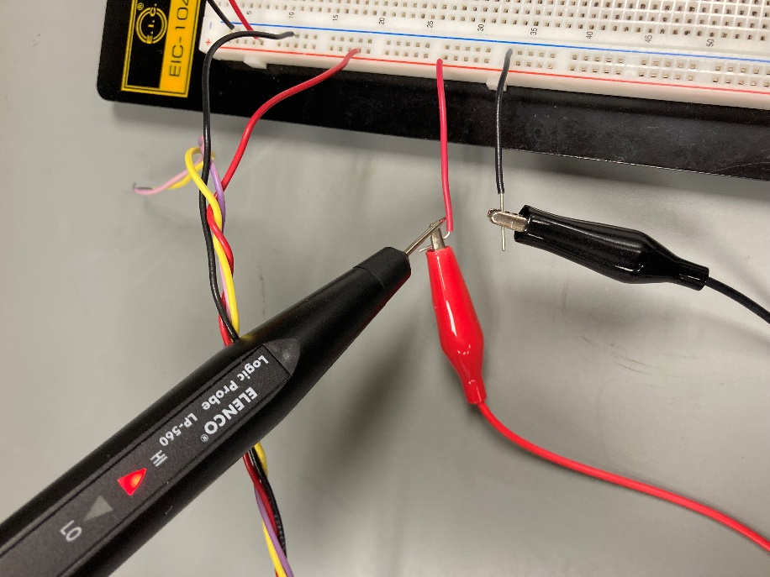
Logic Probe
You can also use the logic probe to check the logic state of a signal.
The green LED will light if the signal is a logic low, and the red LED will light if the signal is a logic high.
There is also a low tone for logic low, and high tone for logic high.
Put the probe on the +5 V and see. Then put probe on Ground.

Slide 12
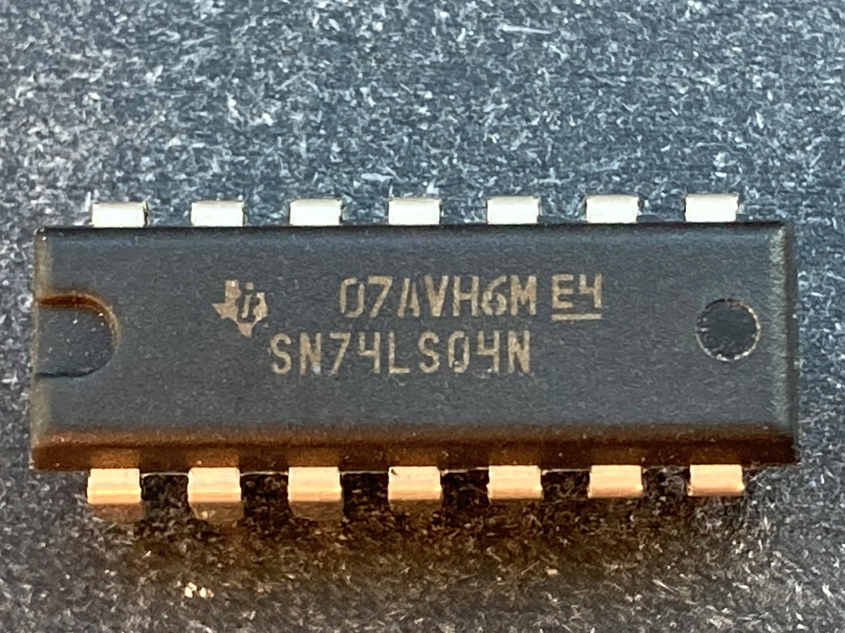
First Logic Circuit
The logic chips we use are in a DIP package. DIP is short for “Dual In-Line Package”. The distance between pins is 0.10 inches. The package is 0.30 inches wide.
We will be using 7400 series LS TTL logic chips. TTL is short for “Transistor-transistor logic”, and LS is short for “Low-power Shottkey”.

Slide 13
First Logic Circuit
The 7400 series was one of the early logic families from the 1970’s.
Several variants of the series have been created since, including S (Shottkey), LS (Low-Power Shottkey) which is the type we use, and HC (high-speed CMOS).
Other logic series have also been created, such as 4000 series CMOS.
The difference is in what type of transistors are used to make them.
For this lab, the first two digits will always be 74, then LS, and the next digits identify the function of the chip
74LS04 – Inverter
74LS08 – AND
74LS32 – OR

Slide 14

First Logic Circuit
The part number is printed on the top of the chip. It can be a bit cryptic, and there are often extra letters and lines:
The full part number is SN74LS04N
The letters before the 74 usually identify the manufacturer. There is no real standard – manufacturers just picked some letters that no one else used. SN means “Texas Instruments”.

Slide 15
First Logic Circuit
The extra letters at the end usually identify the temperature grade, and the package style.
The N identifies the package type, which is PDIP, which just means plastic DIP package.
Originally there was just DIP packages, but now there are several variations.
SOIC (Small Outline IC), SOP (Small outline package), SO (Small outline), SSOP, QSOP, TSOP, LCC (Leadless chip carrier), BGA (Ball-grid array), and more…

Slide 16
First Logic Circuit
Often there is another letter which encodes the temperature grade of the chip. If there is no code, it usually means the chip is commercial temperature grade, which means the operating specification are guaranteed over a temperature range of 0C to 70C.
The performance of semiconductors varies over temperature, which is why it has to be specified.

Slide 17
First Logic Circuit
Note that the first line is NOT the part number in this example. It is some manufacturer specific codes, usually identifying where the chip was made and when.
Typically the manufacture date is encoded as 4 digits. First 2 digits are the week of the year, and second two are year. 2420 would be 24th week of 2020. This chip uses a non-standard coding.

Slide 18
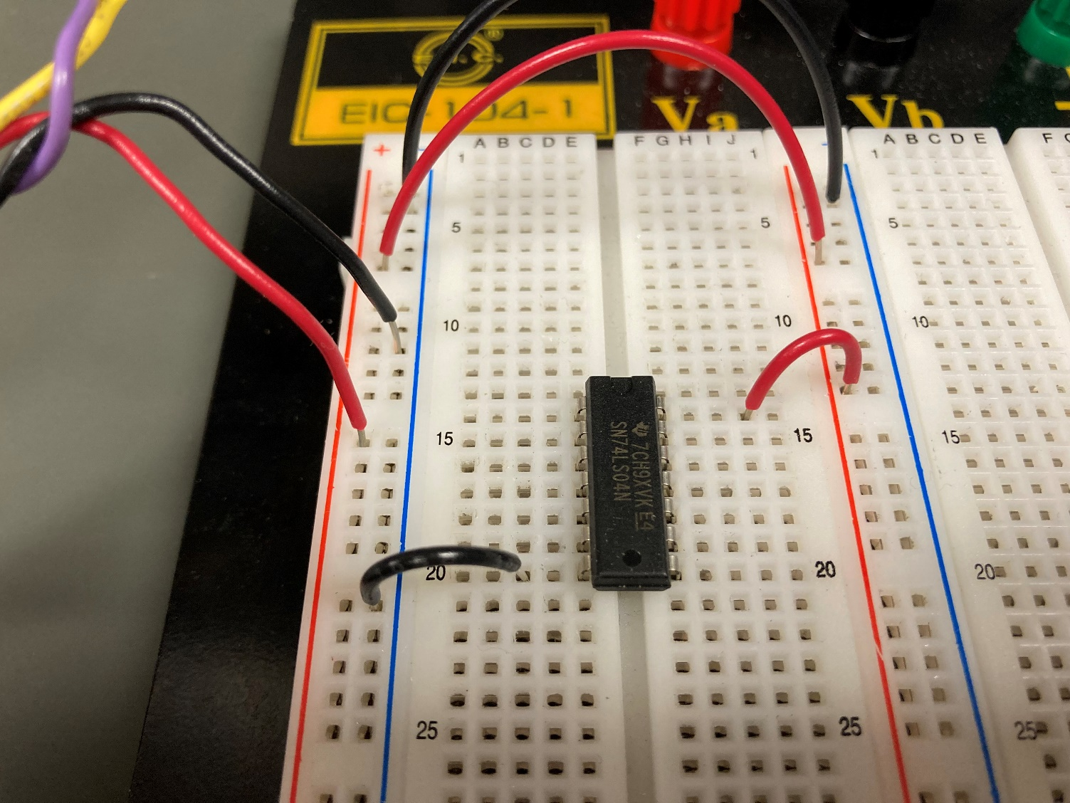
First Logic Circuit
Find a “74LS04” hex inverter from the parts bins. The “hex” just means there are 6 identical inverters in the same package.
Plug the inverter into your breadboard as shown. You can plug it anywhere as long as it straddles the center channel on the breadboard.

Slide 19
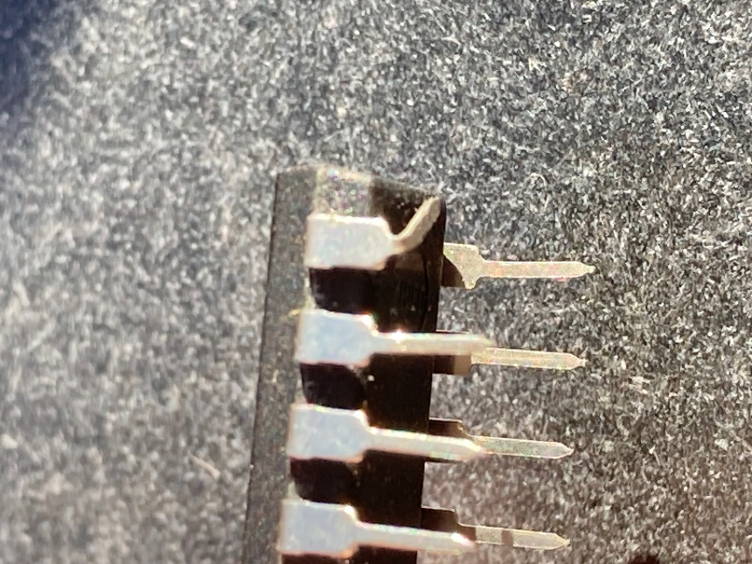
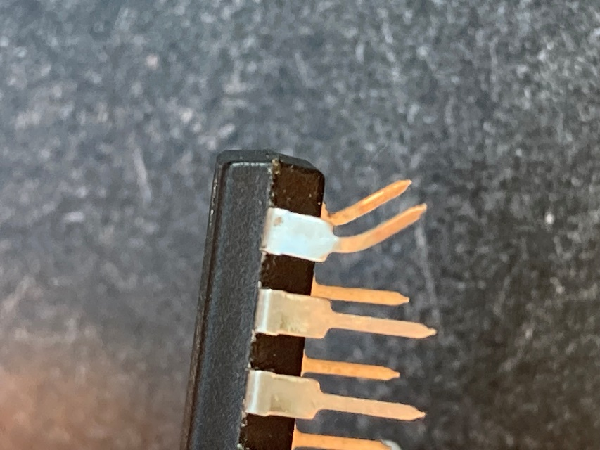
First Logic Circuit
Check the pins to make sure they are not bent or folded under.
Folded under pins can be difficult to find, because once the chip is plugged into the breadboard, it looks fine – BUT IT ISN’T!!
You can gently bend pins back with the pliers, but sometimes they will break.
When removing chips from breadboard, pull them straight out to avoid this problem.

Slide 20
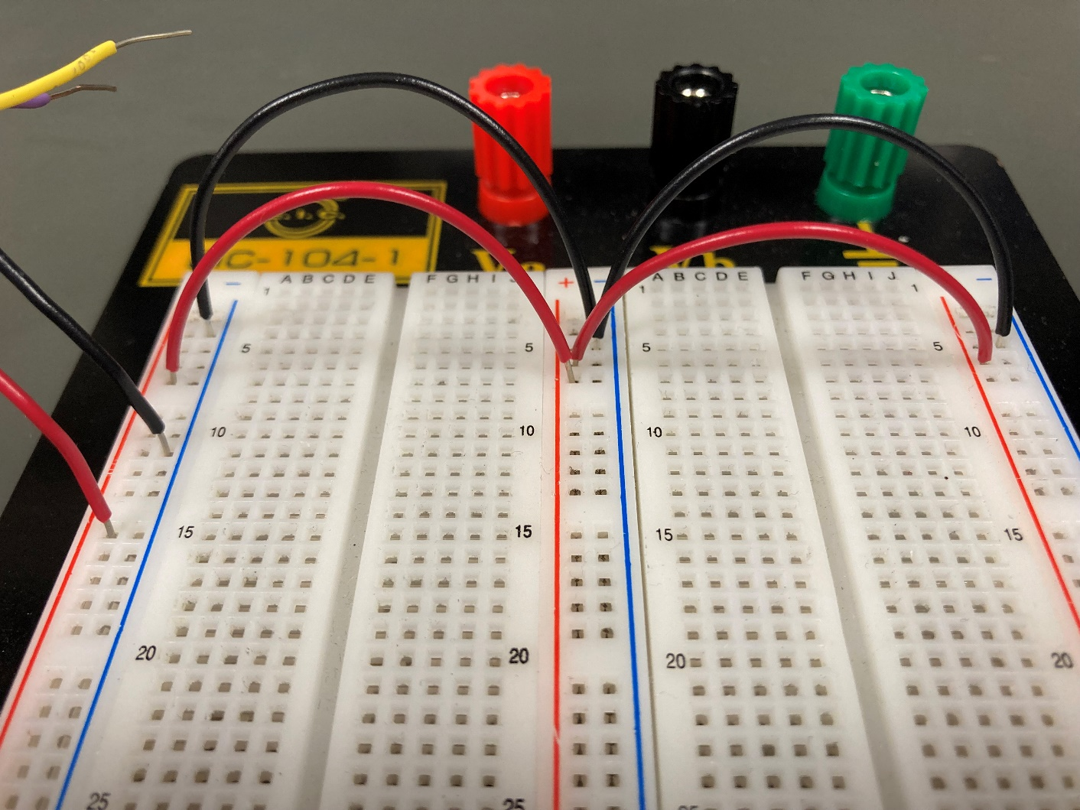
Wiring
The power/ground busses are all separate, so you have to jumper to connect them.

Slide 21
First Logic Circuit
All the logic chips will require +5V in order to work. For the 74LS04, power goes to pin 14, and ground goes to pin 7.
There is a dot or a notch on one end of the chip. Orient the chip with the dot or notch to the left. Pin 1 is on the bottom left corner. From there the pins are numbered in a counter-clockwise direction. Pin 14 is in the upper left corner.
14
8
1
7

Slide 22

First Logic Circuit
Using a red wire jumper, connect from the +5V bus to pin 14 of the inverter.
Using a black wire jumper, connect from the ground bus to pin 7 of the inverter.

Slide 23
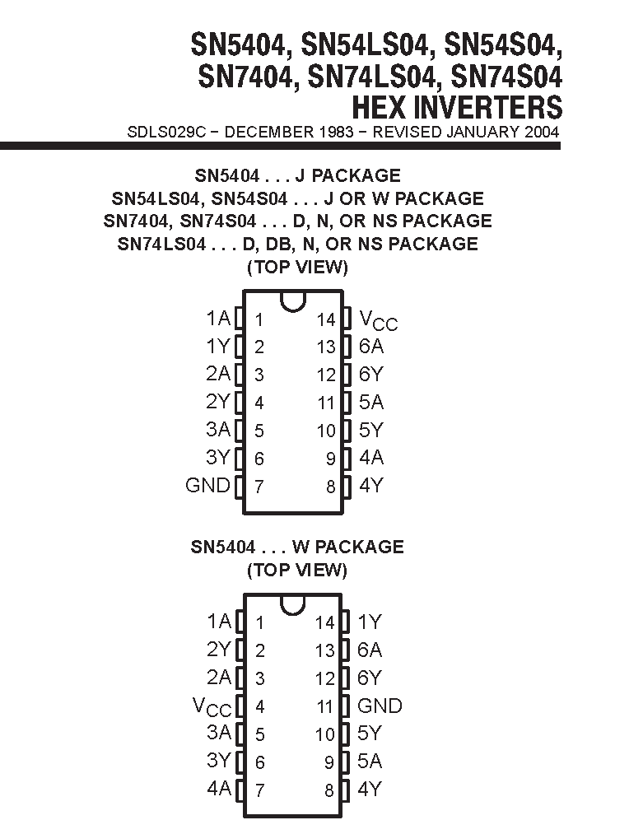
First Logic Circuit
The function of the pins, called the pinout, is described in the manufacturer’s data sheet for the part.
It is not always obvious – the inverter input is A, and it’s output is Y. They are numbered 1 to 6.
Pin 1 is the input to inverter 1 (1A), pin 2 is the output of inverter 1 (1Y)
The pinout for different package types is often provided, like here for the SN5404, which is the military grade version.

Slide 24

Wiring
Please color code your power and ground wires. That makes it easier to identify wiring errors, and easier for your TA to help you if your circuit is not working.
Don’t use red and black for the signal wires – there are plenty of other wire colors in the lab.

Slide 25
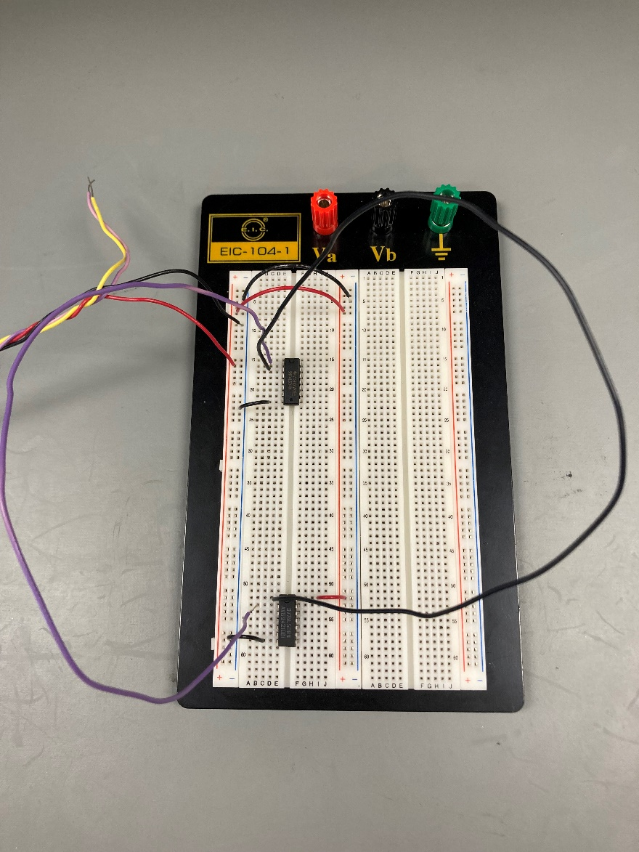
Wiring
Try to position chips near each other that have a lot of wiring connections between them.
These chips could be closer together.
Avoid excessively long wires.

Slide 26
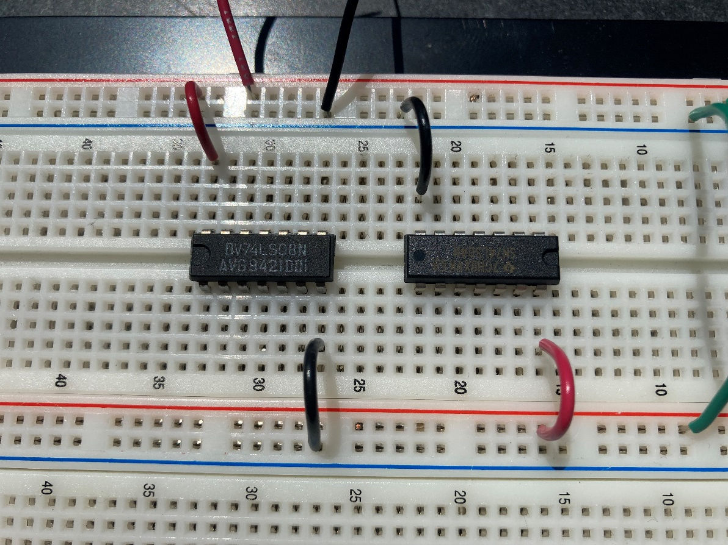
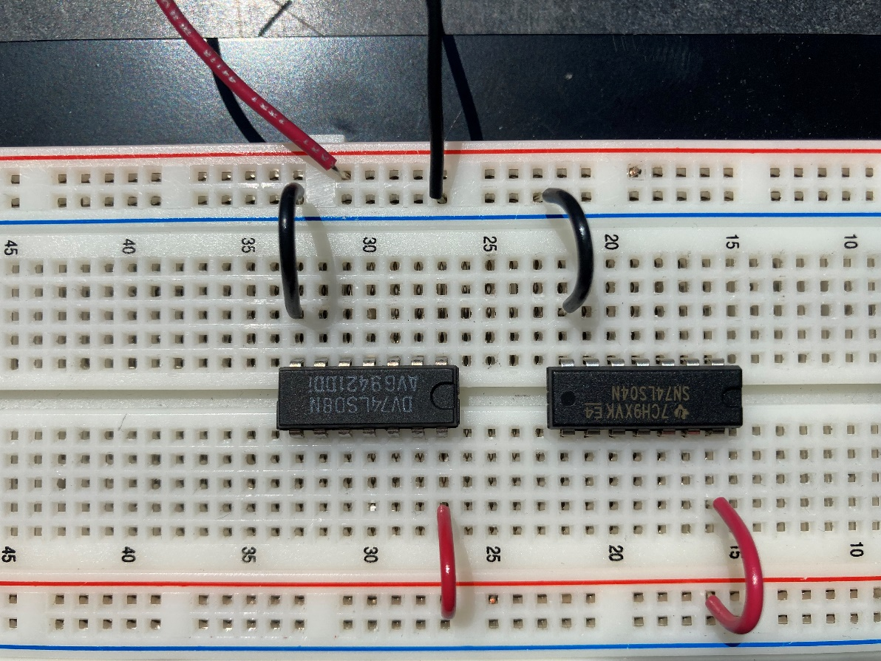
Wiring
Put all the chips with the notch the same way!
Keeping them all pointed the same way is one less thing to worry about.
NO
YES

Slide 27
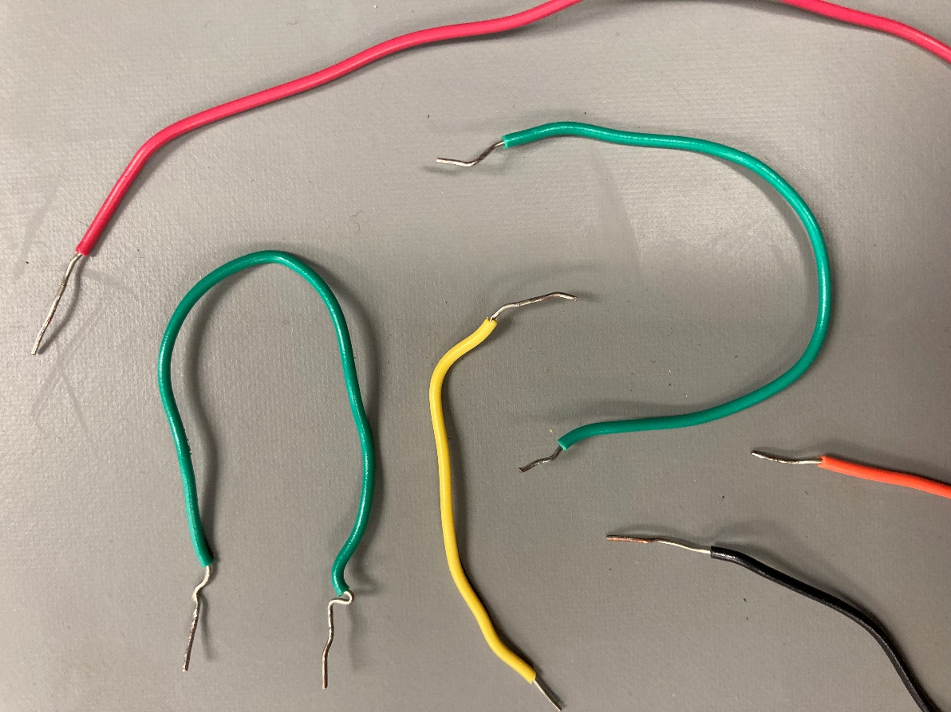
Wiring
Cut off and re-strip the ends of wires if they are mangled. It will be difficult to insert mangled wires into the breadboard.

Slide 28

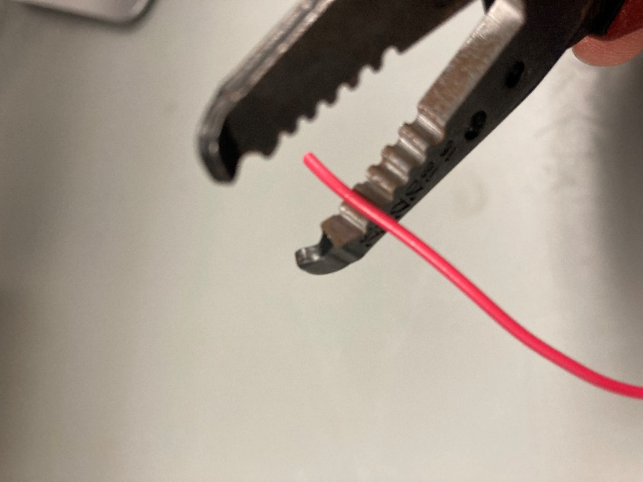
Wiring
Use the second notch down from the end for stripping the wires.
The notch will be labeled 24, which is for stripping 24 AWG wire.
AWG is short for “American Wire Gauge” which is a wire diameter standard.

Slide 29
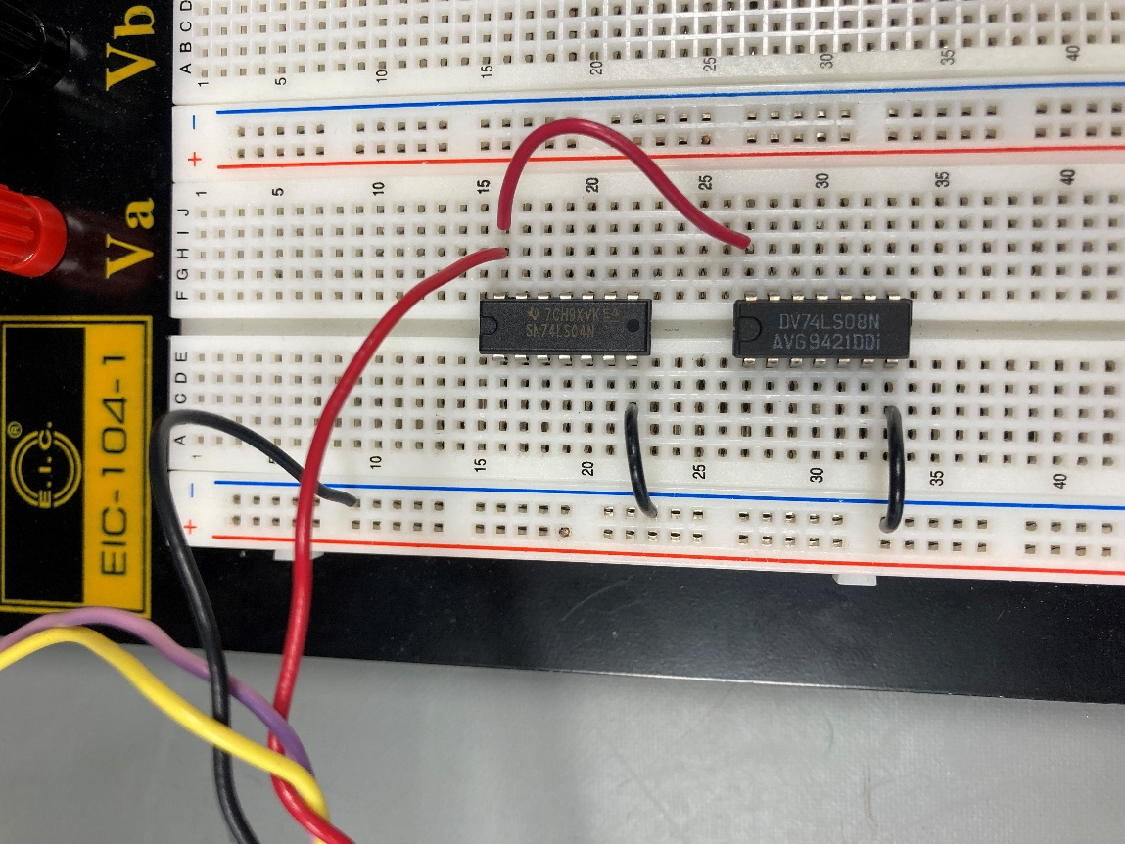

Wiring
Don’t “daisy-chain” the power connections to the chip. Jumper from the power/ground bus to the chips.
NO
YES

Slide 30
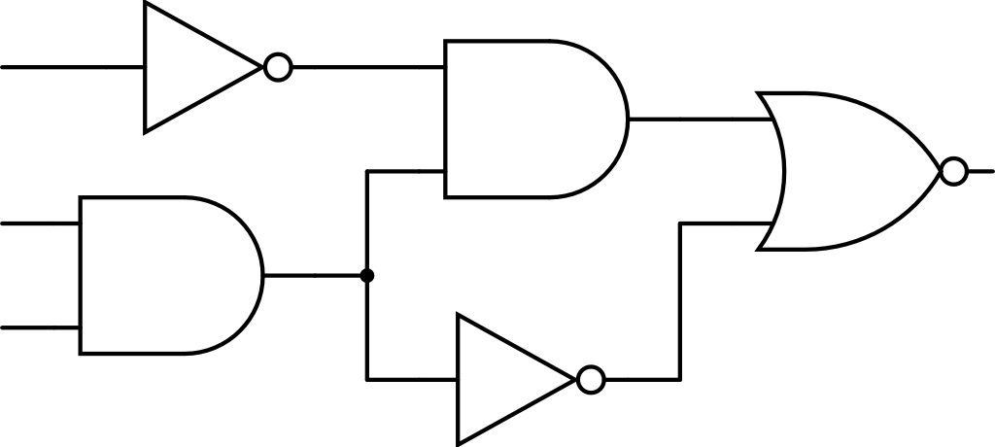
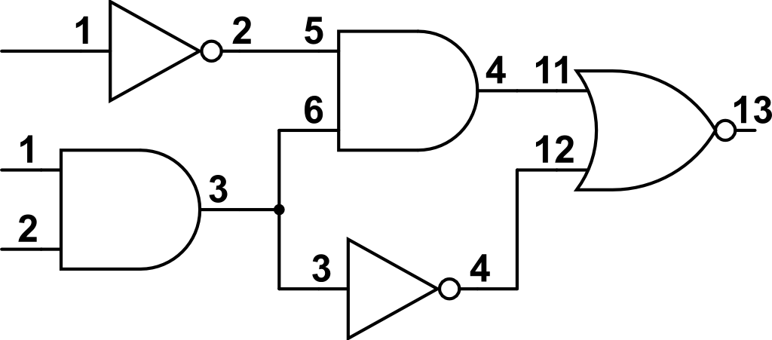
Wiring
Draw a schematic, and label all the pin numbers.
Many logic chips have more than one gate in them. It is very difficult to remember which gate you used where.
Which circuit would you rather wire?
NO
YES

Slide 31
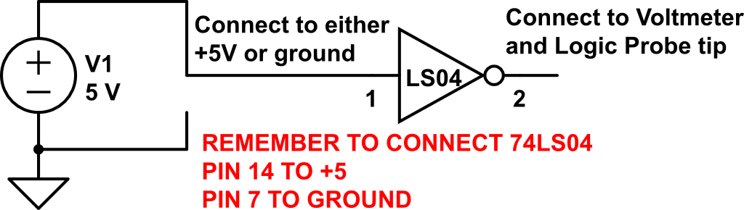
First Logic Circuit
Put a jumper from pin 1 of the 74LS04 to +5V. Pin 1 is the input of the first inverter in the chip.
Connect your voltmeter and logic probe to pin 2.

Slide 32
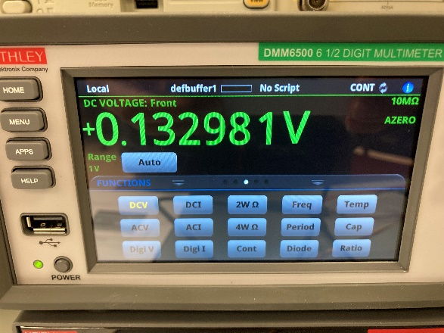
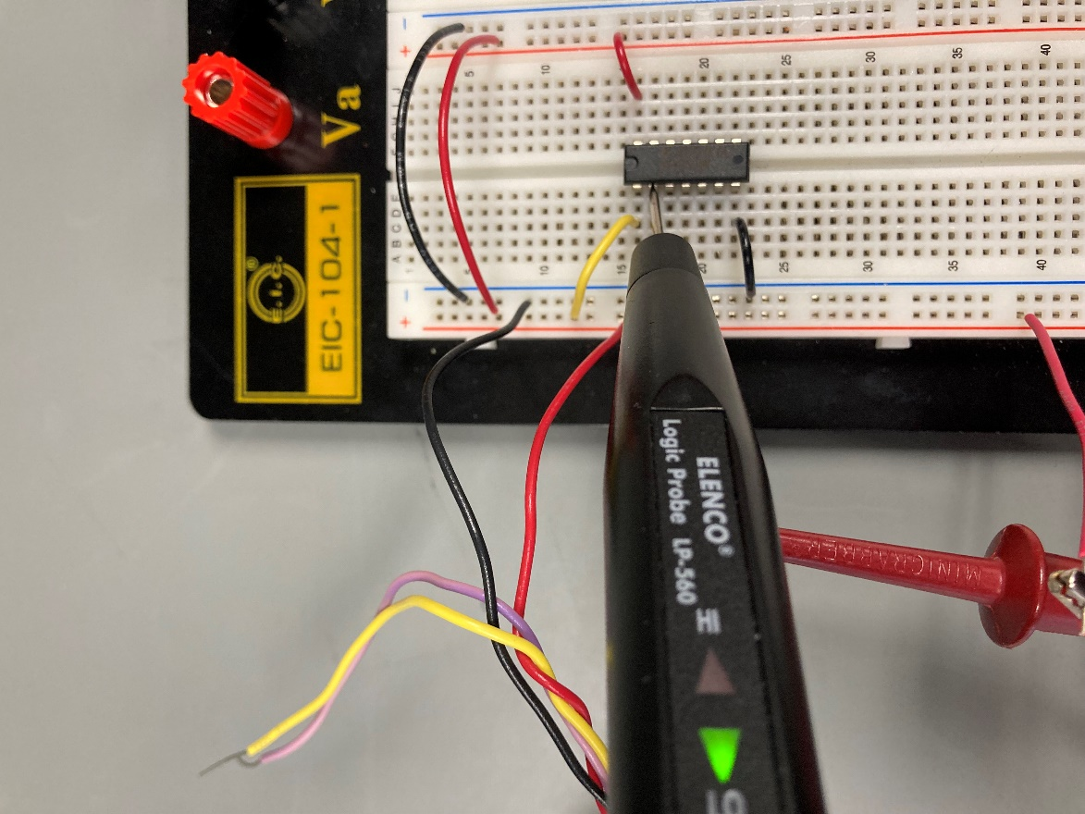
First Logic Circuit
What do you see?
With a logic 1 (+5V) going in, a logic 0 (0V) should be coming out.
Note the voltmeter shows close to 0V, but not exactly.
Move the pin 1 jumper to +5v.
Check the logic level on pin 2 again. What do you see now?

Slide 33
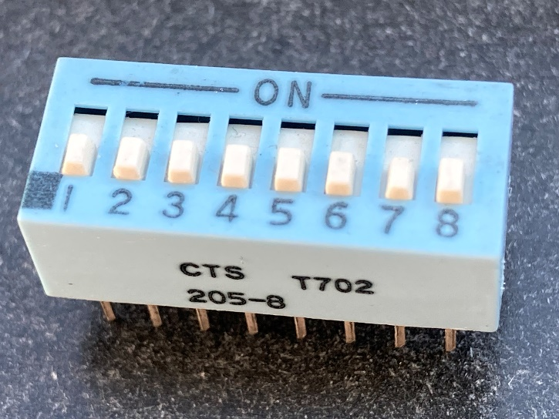
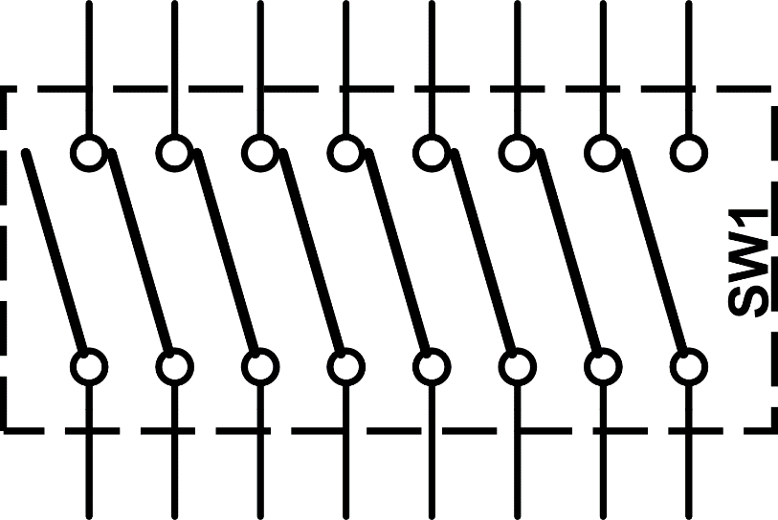
Using Switches for Inputs
Using wires to create a logic input is annoying – it’s better to use some switches.
Get an 8 position DIP-Switch from the parts bins.
There are 8 individual “SPST” switches in a single package, wired as follows.

Slide 34
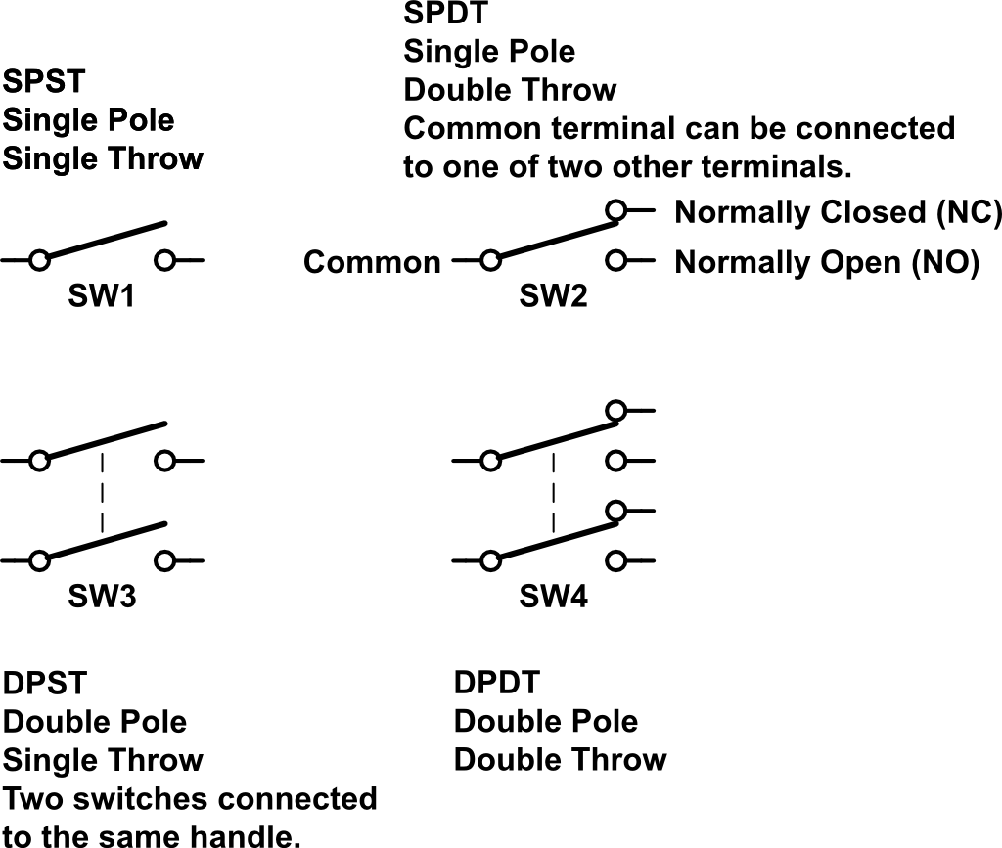
Switches Types
SPST means “Single-pole, Single-throw”.
A switches pole are the number of individual switches that operate with the same handle.
A two pole switch would be two switches that are connected to a single handle, and thus switch at the same time.

Slide 35
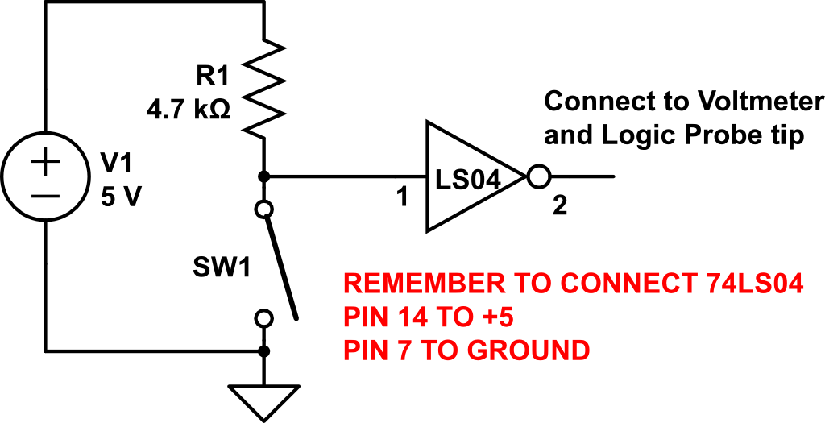
Switches Types
We need to wire a switch to pin 1, but there is a complication.
Logic gate inputs do not like to be left “floating”, or not connected to anything. They should always be at either a high (5V) or low (ground).
One way to solve the problem is by adding a “pull-up” resistor. As long as the value is not too big, this will hold the input high. Then connect the switch from the input to ground.

Slide 36
Switches Types
Wire up one of the switches in the DIP switch and a 4.7k pull-up resistor to pin 1.
Watch what happens to the output on pin 2 as you open and close the switch.
Switch closed is logic low input, which will be inverted and be a high on the output.

Slide 37
Output LEDs
There will be times you need to see multiple logic levels at the same time.
You can drive an LED with a logic gate output, but there are complications.
TTL Logic gate outputs cannot supply much current. They are much better at sinking current – current flowing into the output pin.

Slide 38
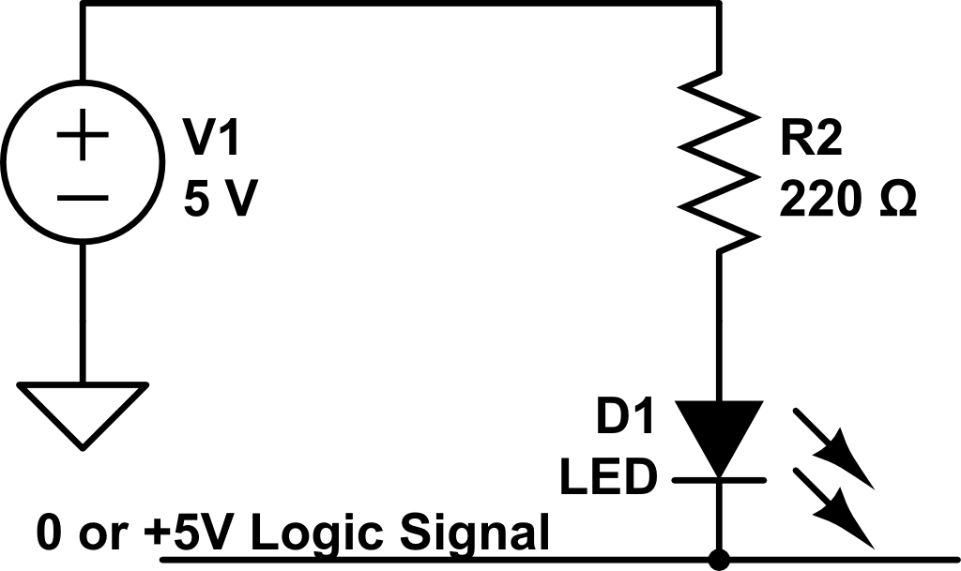
Output LEDs
We can wire up an LED to a logic signal like this, so that when the logic level is low (0V), the LED will be ON.
When the logic level is high (+5V), the LED will be OFF.
But now the LED represents the opposite of the actual logic state. How to fix??

Slide 39
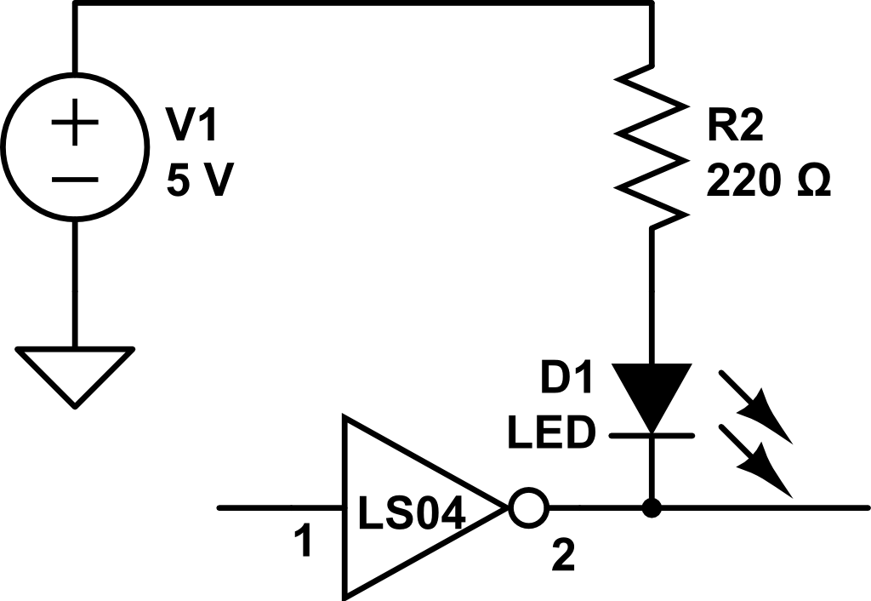
Output LEDs
We can fix the inversion problem by driving the LED with an inverter.
Now, if the input is LOW, the inverter output will be HIGH, and the LED will be OFF.
If the input is HIGH the inverter output will be LOW, and the LED will be ON.

Slide 40
Output LEDs
The resistor in series with the LED does two things.
It limits the current through the LED so it won’t be damaged.
It prevents the logic output from rising too far above ground. When sinking a large current, the output voltage could increase above 2 volts.
This will cause problems for other inputs connected to this output.

Slide 41
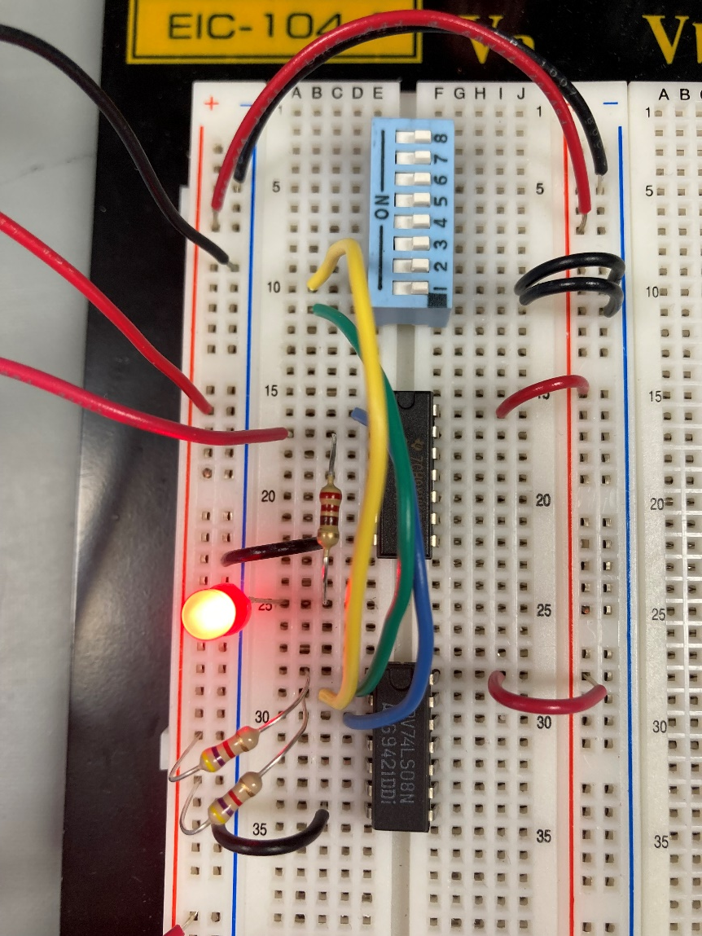
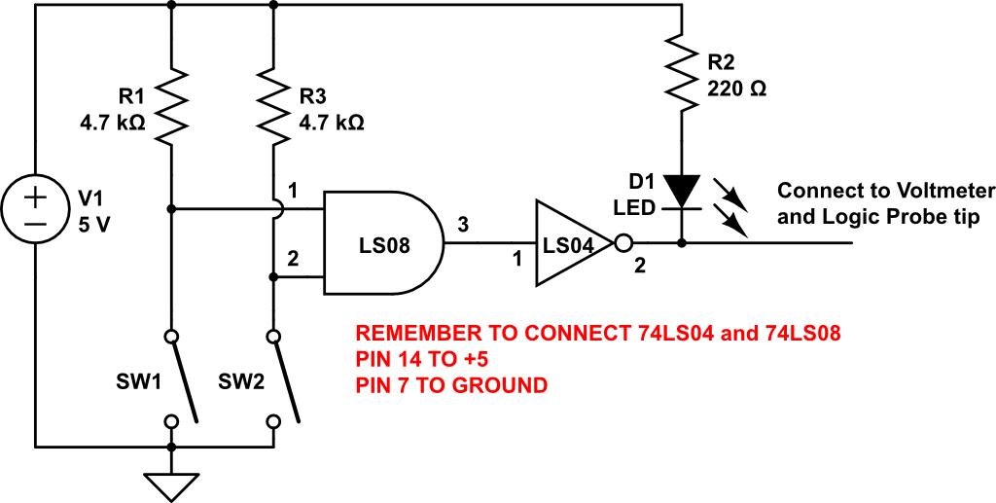
AND Gate
Add a 74LS08 to your breadboard, and connect power and ground.
Connect the output of the first AND gate, pin 3, to the input of the inverter, pin 1.
Wire a switch/resistor to both pin 1 and 2 of the AND gate.

Slide 42

AND Gate
Change the switches and confirm the logical AND function.
Both switches ON will be both AND inputs LOW, so output will be LOW, and LED will be OFF.
Both switches OFF will be both AND inputs HIGH, so output will be HIGH, and LED will be ON.

